Slide 1


Team Managers & Coaches
Pre Season Meeting
May 7th 2022

Slide 2
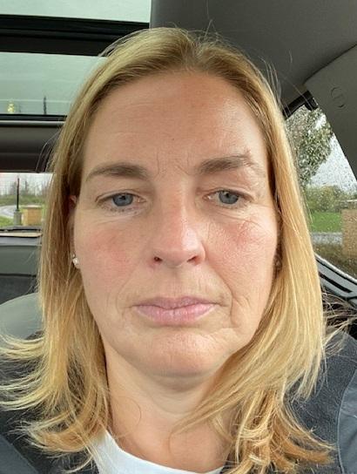



Introductions
Dawn Dinsdale
ERSL & EODSL
League Administrator
Vicki Lowe
EODSA
Executive Director
David Smith
EODSA
Referee Co-ordinator
Andrew Donelle
ERSL
President

Slide 3

The Leagues
EODSL ERSL
20 Clubs 16 Clubs
288 Teams 83 Teams
127 boys development teams 49 boys regional teams
50 boys district teams 34 girls regional teams
67 girls development teams
44 girls district teams
Total teams in 2019 442
Total teams in 2022 371 (84% of 2019)

Slide 4
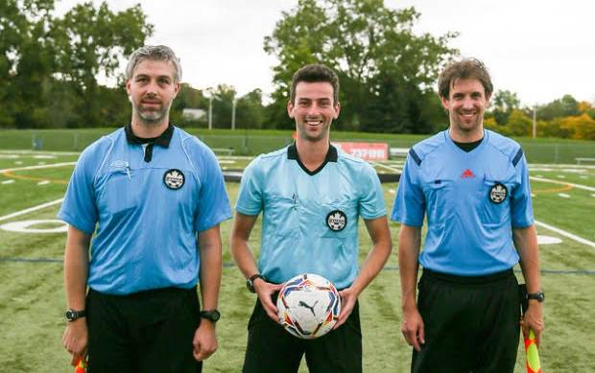



Referees
We have a serious referee shortage in Ontario
2019 8318
2022 2681 (32% of 2019)
2019 1286
2022 351 (27% of 2019)
2019 316
2022 103 (33% of 2019)
You should not expect ARs on your games in 2022
Occasionally some games will not be assigned a referee

Slide 5

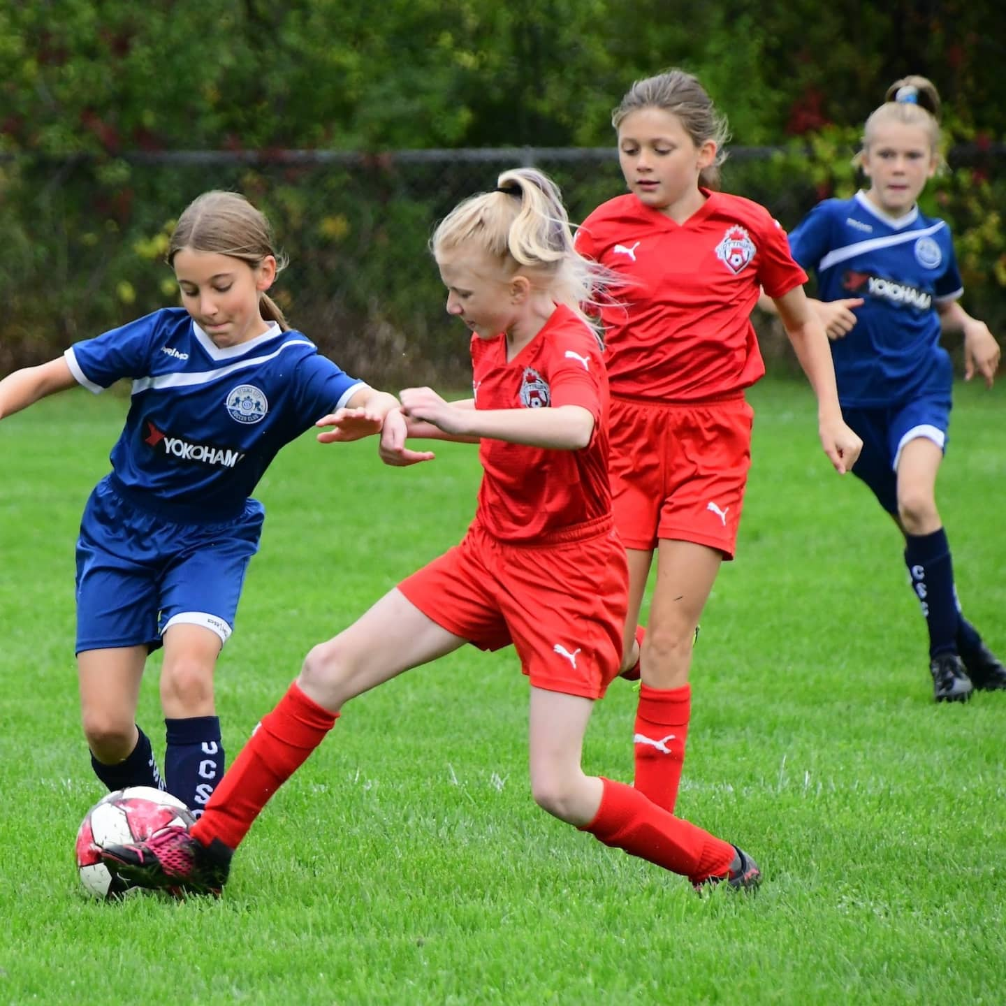
The 2022 EODSL season
Week of May 16th Season starts
Week of July 26th Start of two week mid season break
Week of August 8th Season resumes
Week of August 21st Under 18 season concludes
Week of August 28th Summer season concludes
Week of September 5th Break
Week of September 12th Optional 6 week Fall season starts
Week of October 17th Optional 6 week Fall season concludes

Slide 6
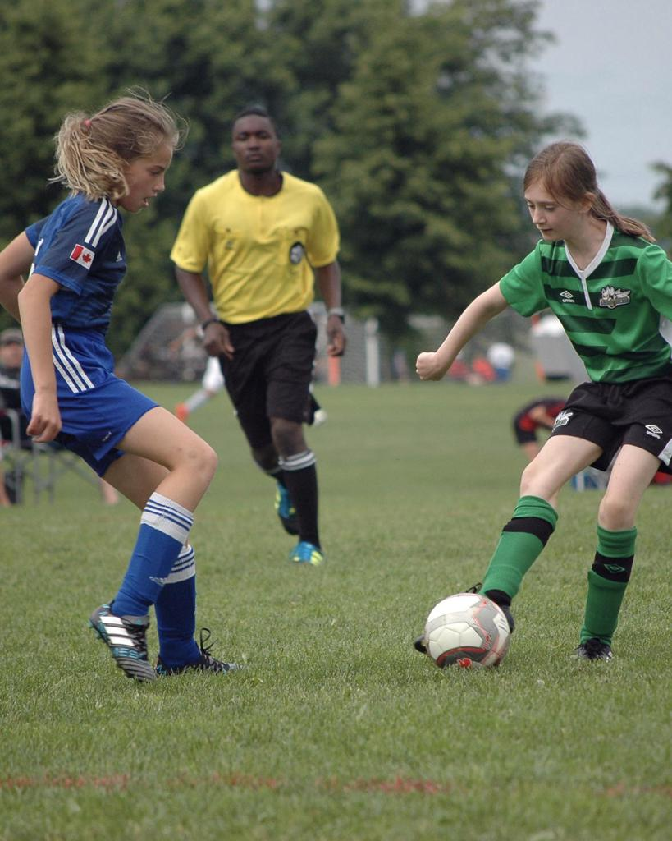
The 2022 ERSL season
Week of May 16th Season starts
Week of July 26th Start of two week mid season break
Week of August 8th Season resumes
Week of August 21st Under 18 season concludes
Week of September 19th Summer season concludes
(Sunday September 25th)

Slide 7
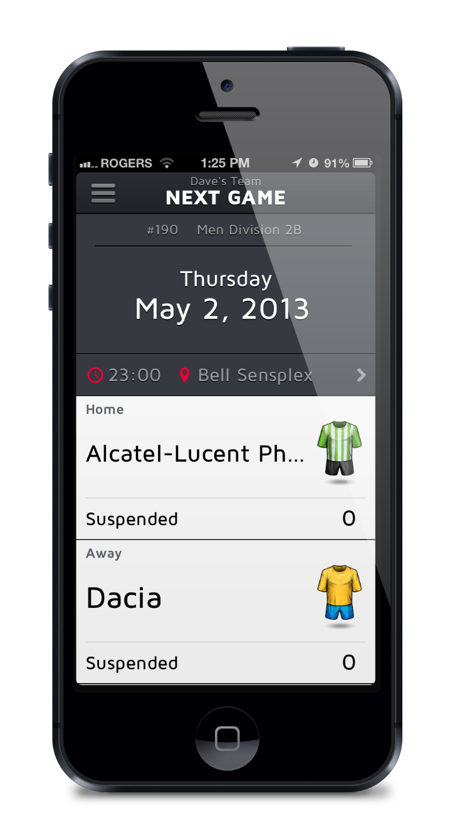
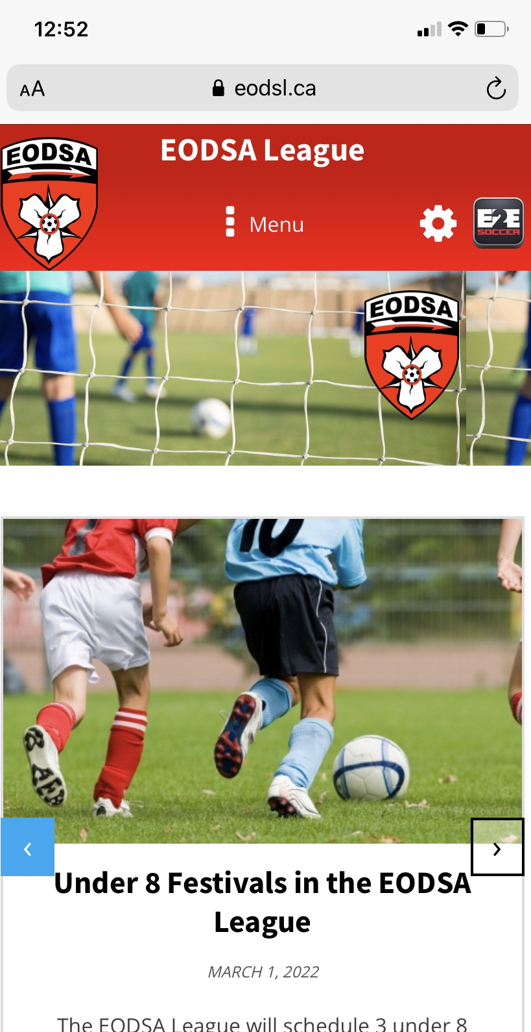
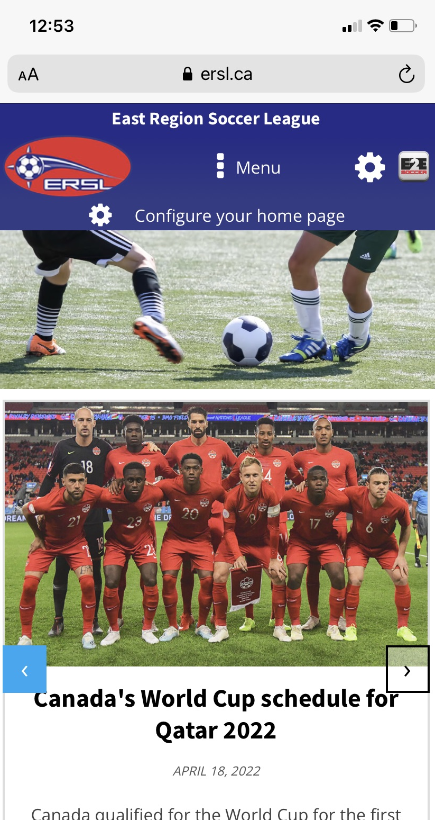
New websites
Your new 2022 website is now mobile
friendly
The new site will allow us to keep
you posted of league and other
soccer news
Important
Please go to the About section of the
website and familiarize yourself with
the league rules and policies

Slide 8

Setting up your team management account
These tasks need to be done before the start of the season
1. Each coach and team manager needs to perform an activation
process.
Once you have done this your name will appear on a game sheet
2. You team uniform needs to be submitted to the database
3. Your roster needs to be uploaded (U13 and up teams only)
4. If you coach or manage a grassroots team (U9 – U12) then you
do not need to upload your roster. This will be done by your club

Slide 9
Future software releases
Before we go into a demonstration please be aware that we are using a new software system this year
New software is scheduled to be released in the coming weeks
Not all the software that you will require is currently available
The next software release is scheduled for Wednesday May 11 which includes
Game sheets for grassroots teams
Photo ID for players( i.e. digital cards)
Reschedule game requests
Deleting players from roster
Calls ups

Slide 10
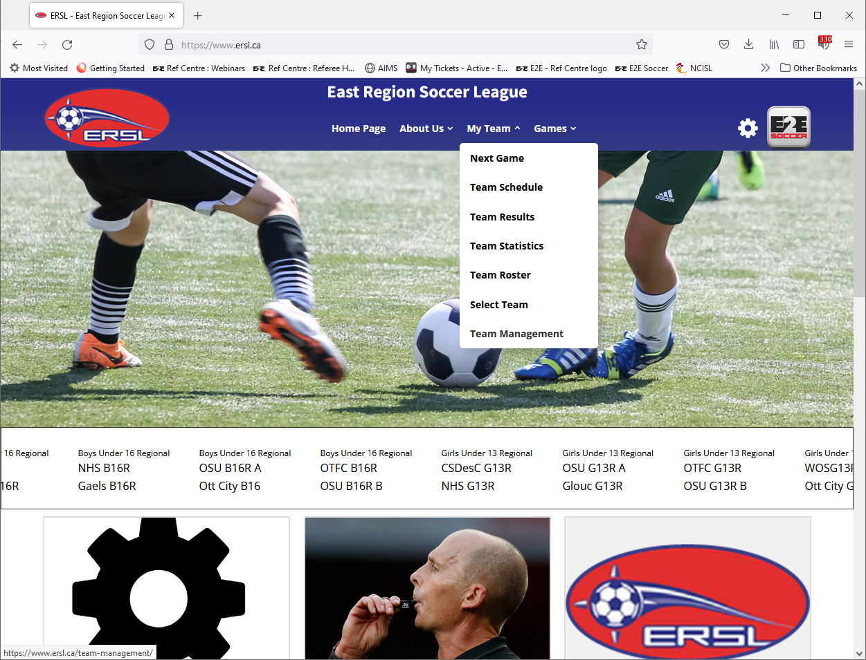
Go to the My Team menu and
select Team Management

Slide 11
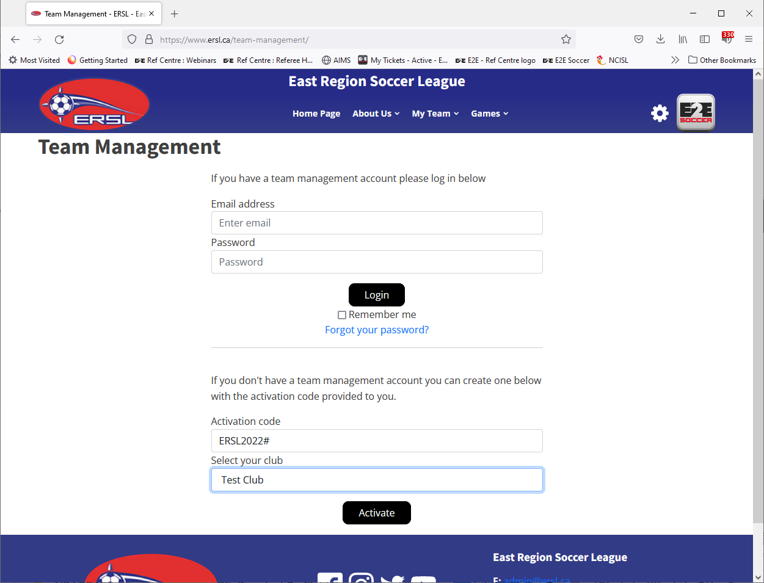
Activate here
Activation codes are
For the ERSL
- contact your club
For the EODSA League
- contact your club

Slide 12
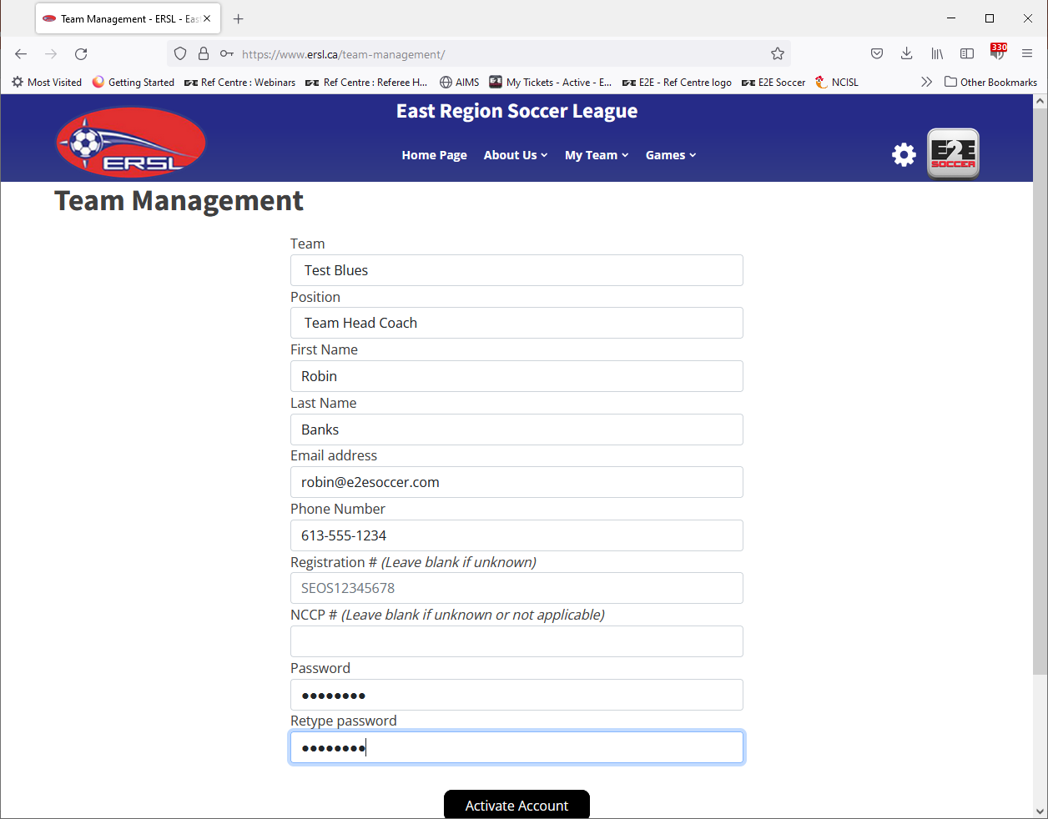
Make sure that you select the
correct team
Fill in the form as requested then
click the ‘Activate Account’ button

Slide 13
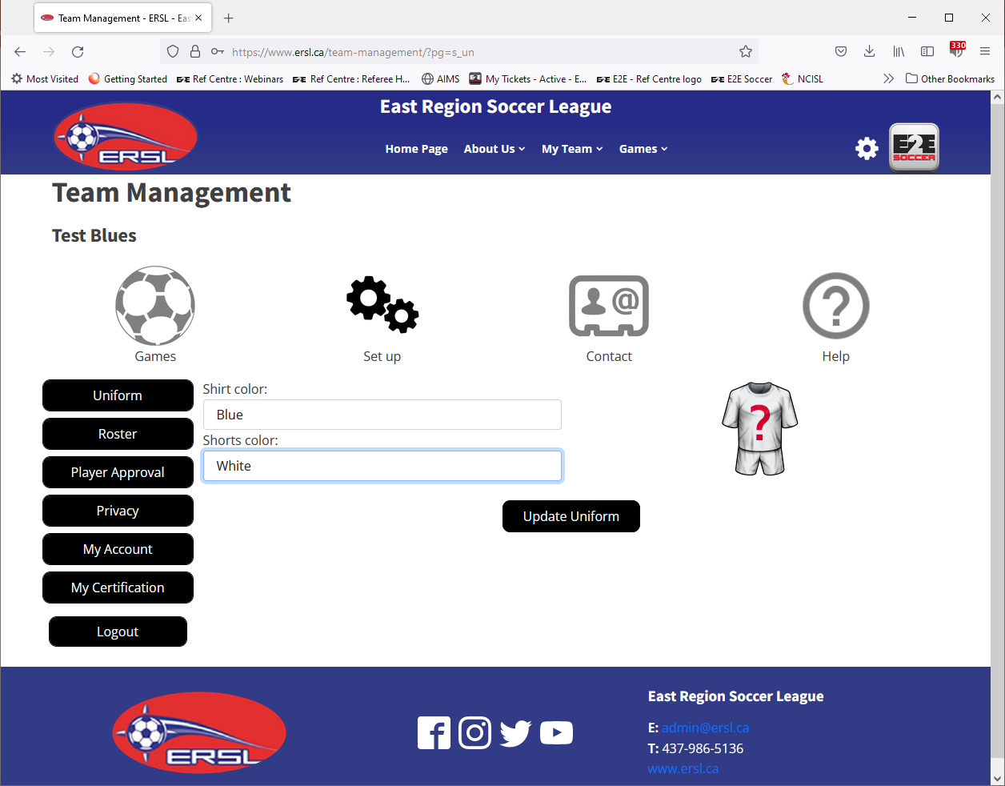
After you have activated you will
be taken to the uniform page
Please enter your primary uniform
and click the ‘Update Uniform’
button

Slide 14
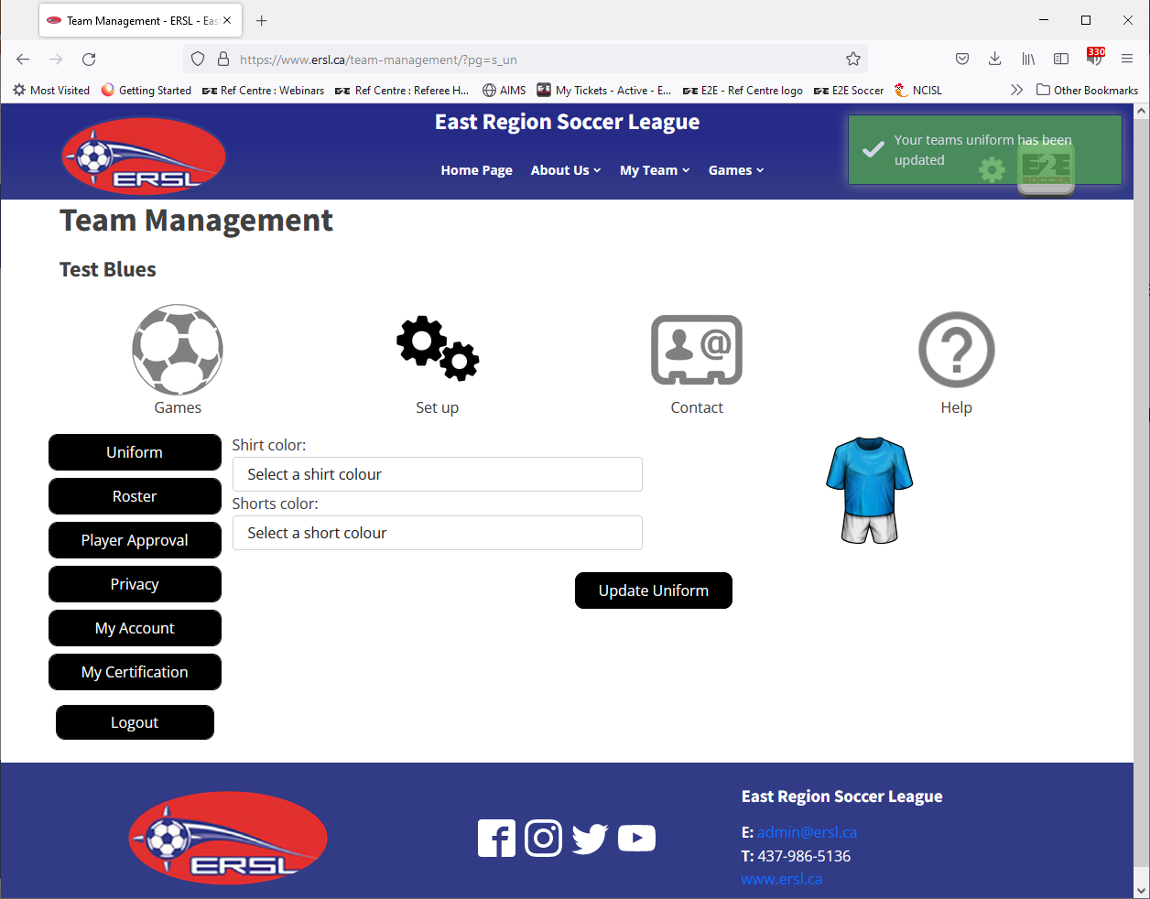
A confirmation message will
appear at the top right
Confirmation messages will be
displayed for 5 seconds
Green is for a good action
Red is for a error message

Slide 15
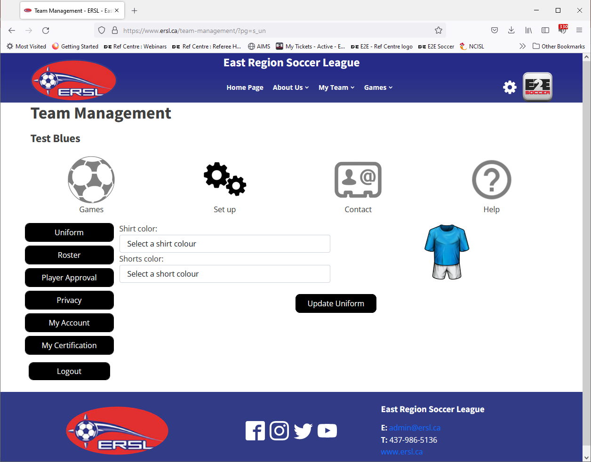
There are 4 sections in the
Team Management module
Games
Set Up
Contact
Help
The icons act as tabs
Click on the icon to move between
sections

Slide 16
In each section there are a set of
tools

Slide 17
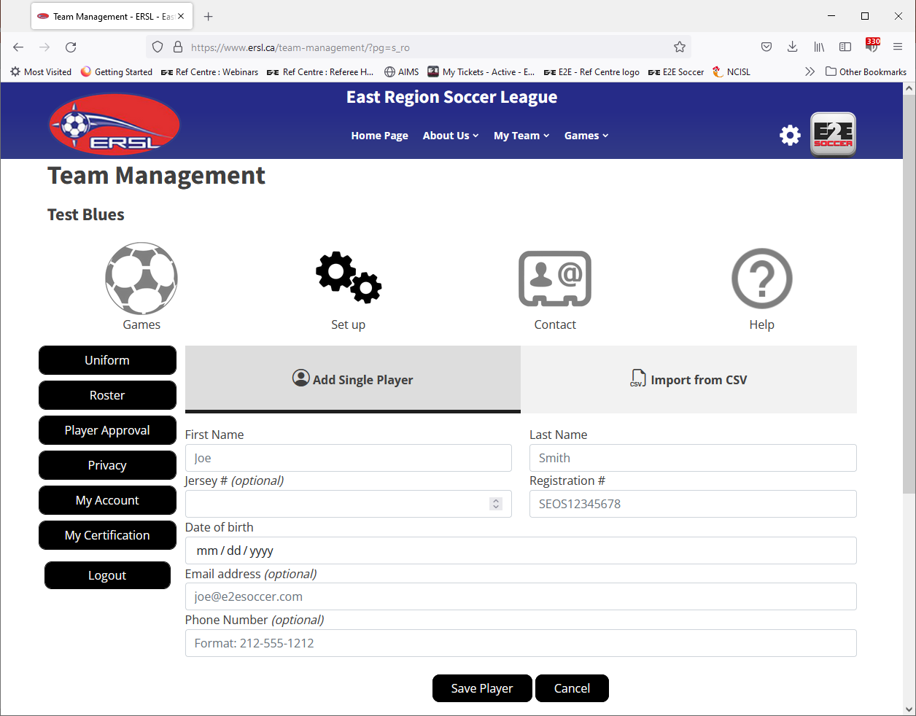
Teams U13 and higher need to
enter a roster using the Roster tool
You have 2 methods to add your
roster
When you add a single player you
enter the text on the form and click
the ‘Save Player’ button

Slide 18
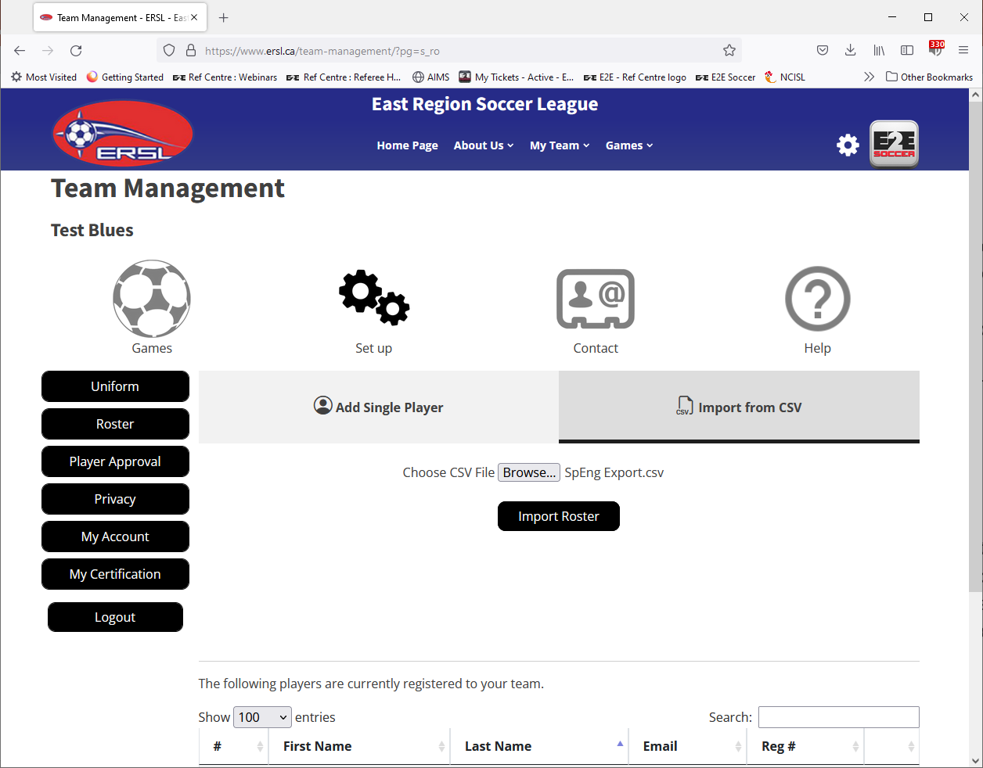
The second option is to import your
Roster from a .csv file
You can get a copy of your roster in
.csv format from Sports Engine or
your clubs registration system
Alternatively you can create your
own .csv file
Tip
If you use a Sports Engine csv file
make sure that you remove the
coaching staff first, otherwise they
will also be added as players

Slide 19
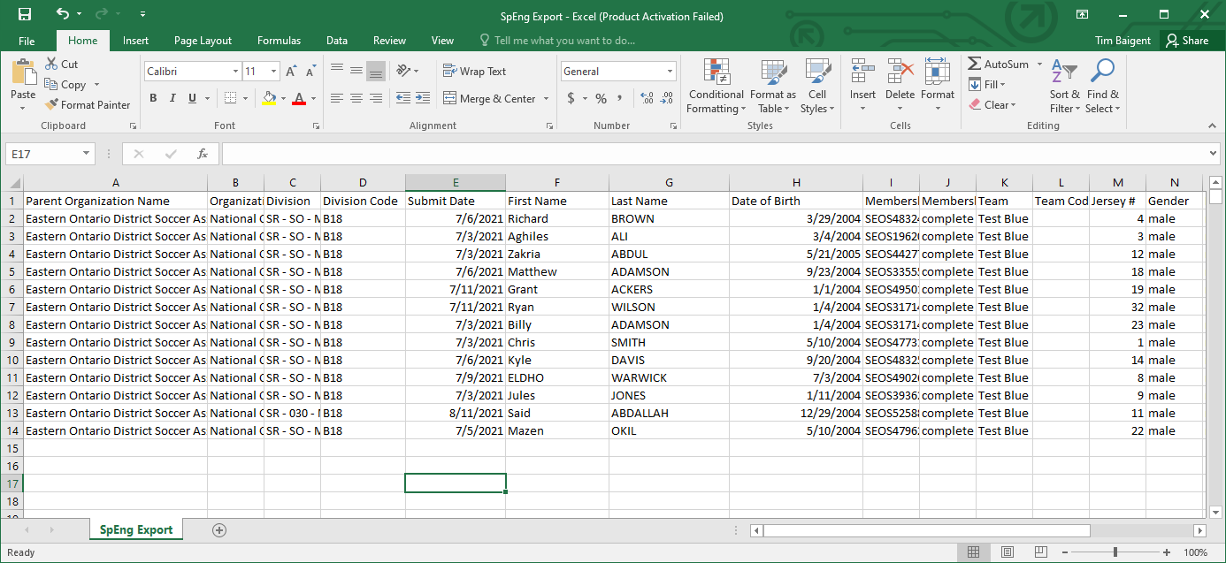
This is a .csv file from Sports Engine
If you are missing contact information or jersey #s you can edit the file before you upload

Slide 20
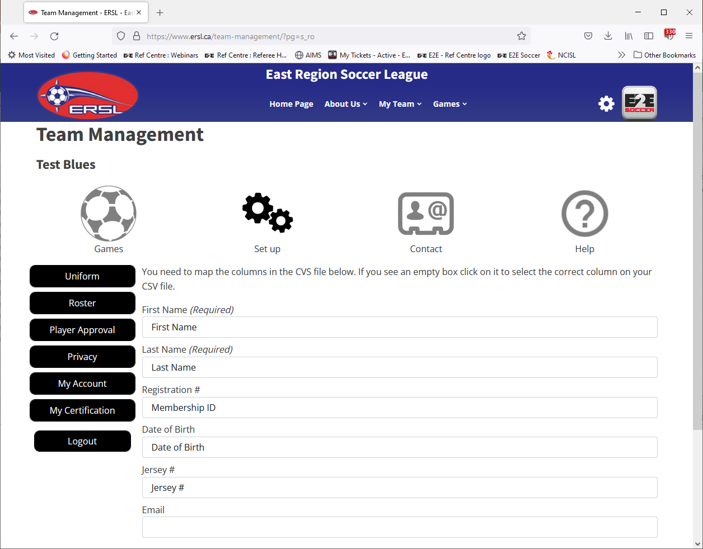
You will then be asked to confirm
the .csv columns with the
Requirements
You can see here that email is
Empty
To try and find email click on the box

Slide 21
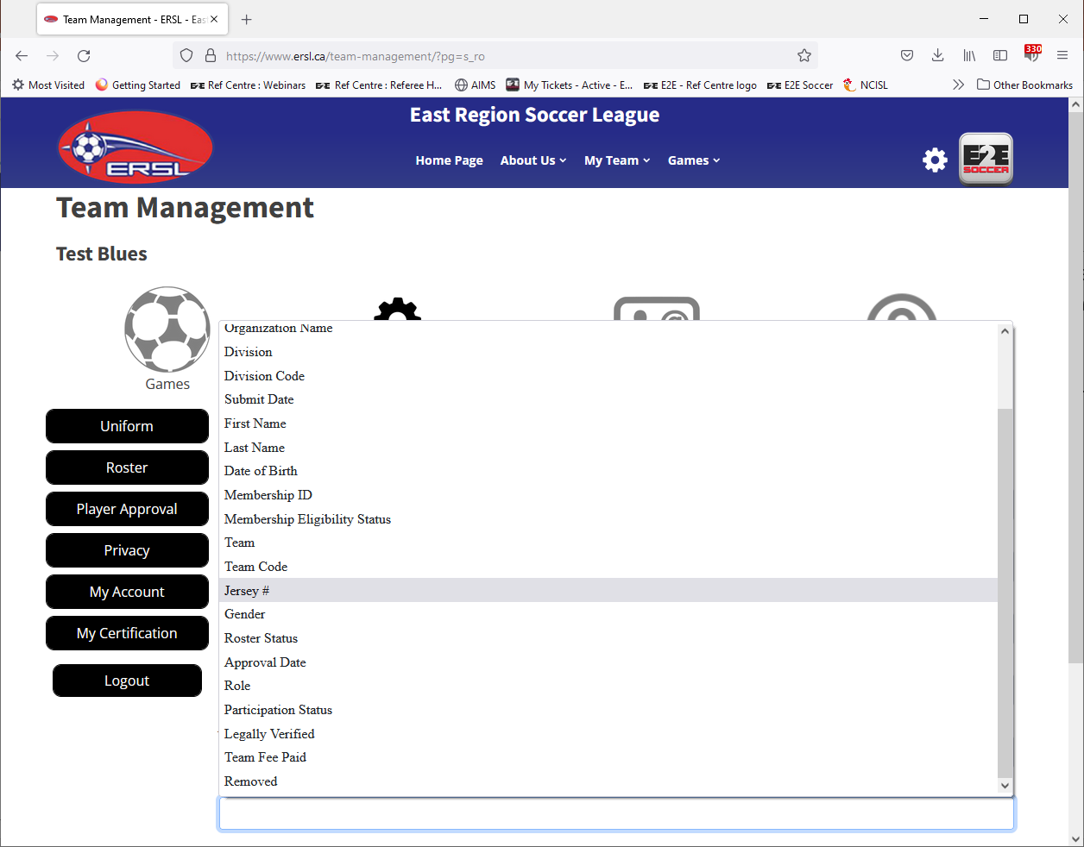
Now all the columns on the .csv file
are listed so you can select the
correct one
Unfortunately in this example email
address is not included so you will
have to add it to the .csv file

Slide 22
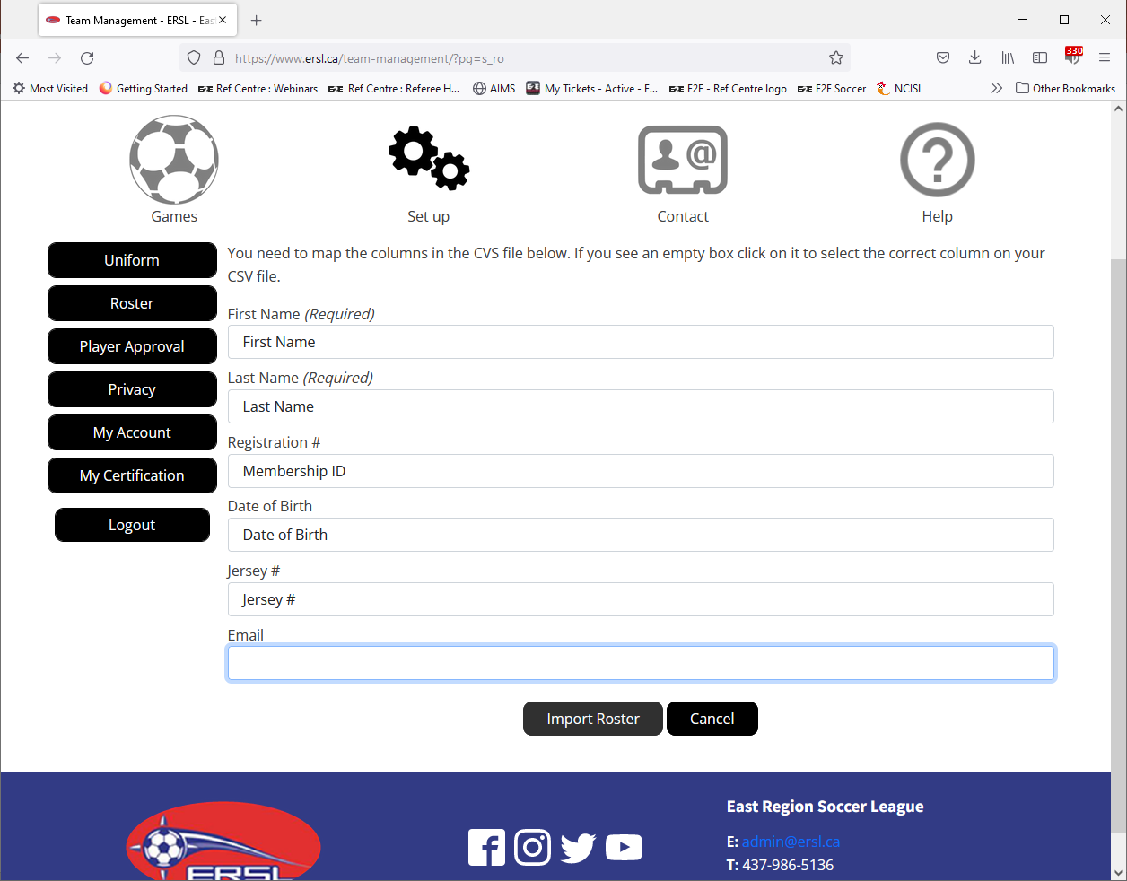
Click the Import Roster button
when you are satisfied that the
mapping is complete

Slide 23
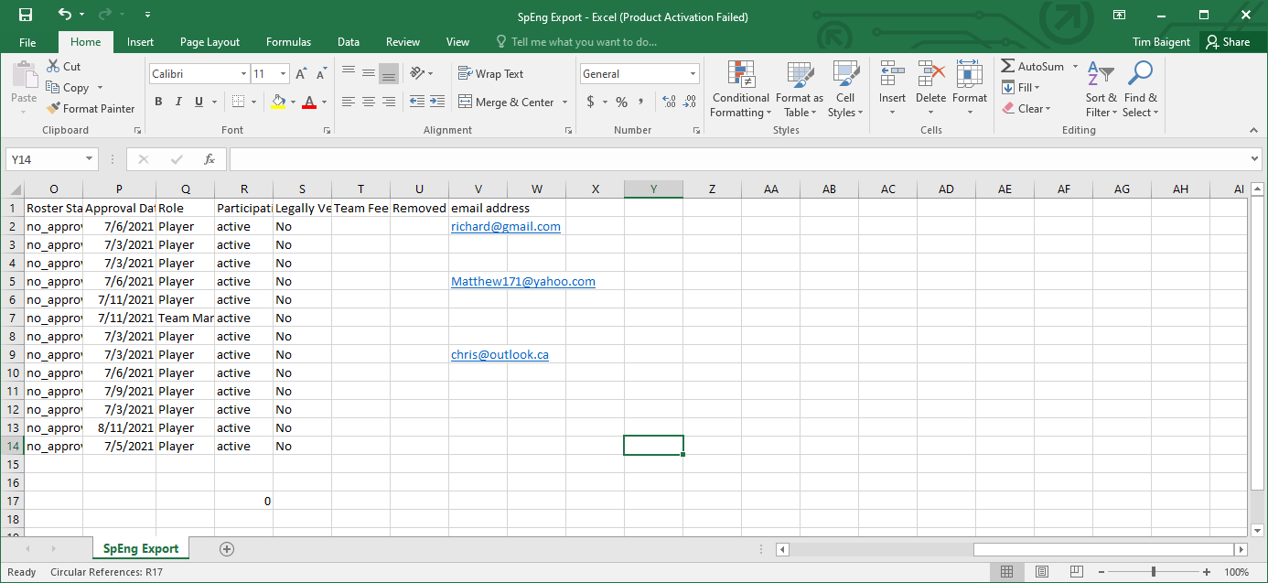
Column V has now been added

Slide 24
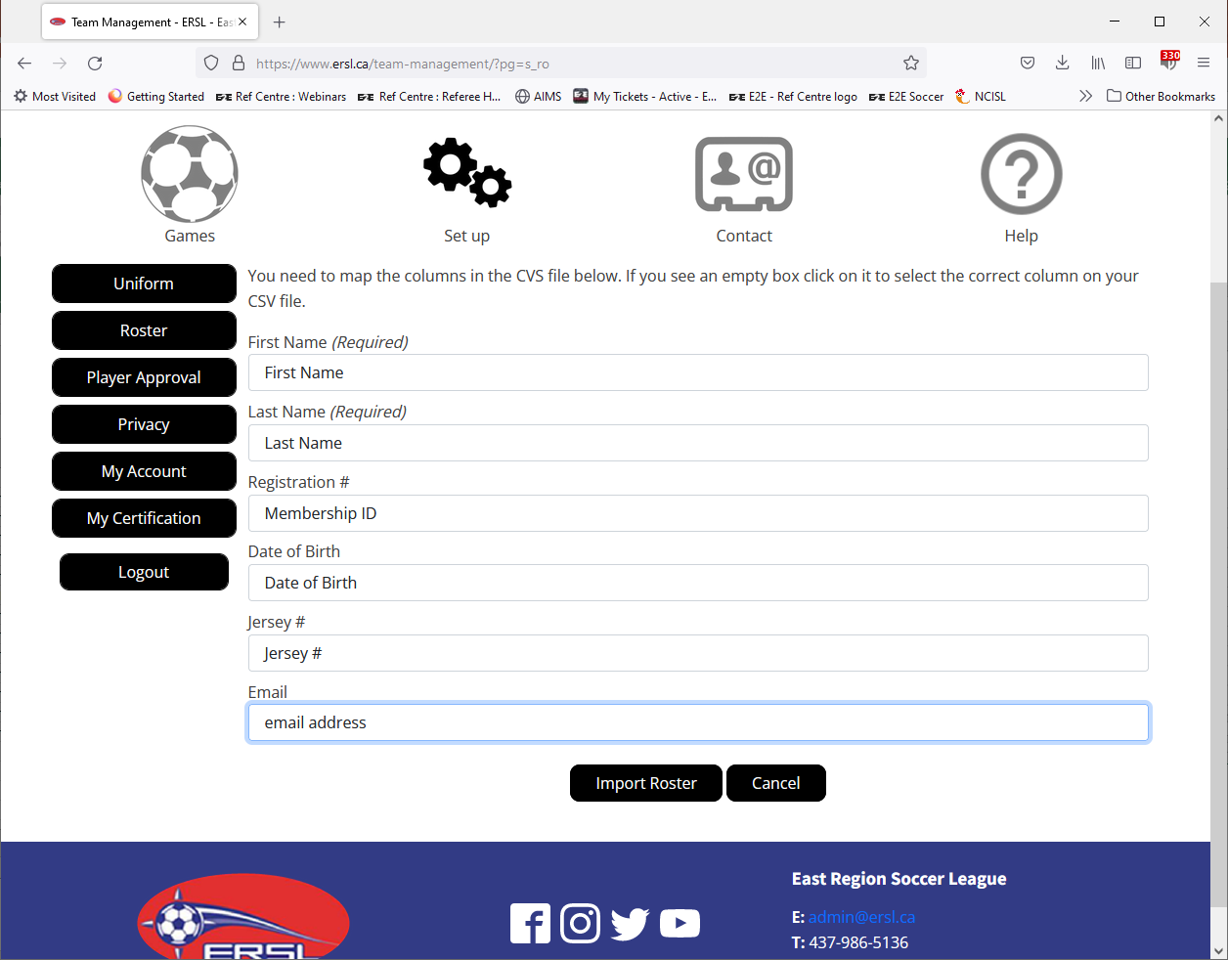
Now I have updated the mapping
Click Import Roster

Slide 25
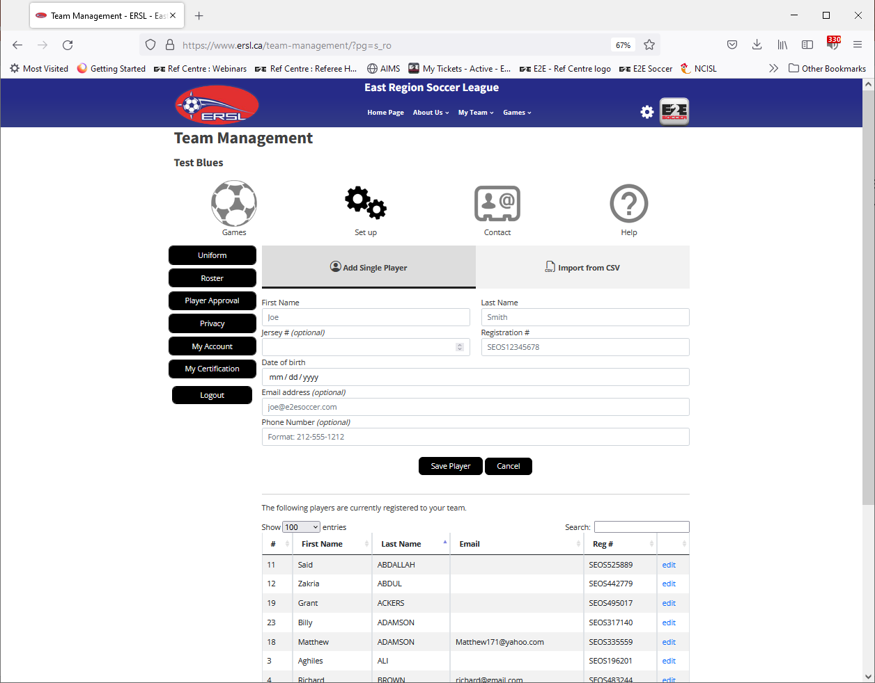
The import was successful and
the players are listed at the foot
of the page

Slide 26
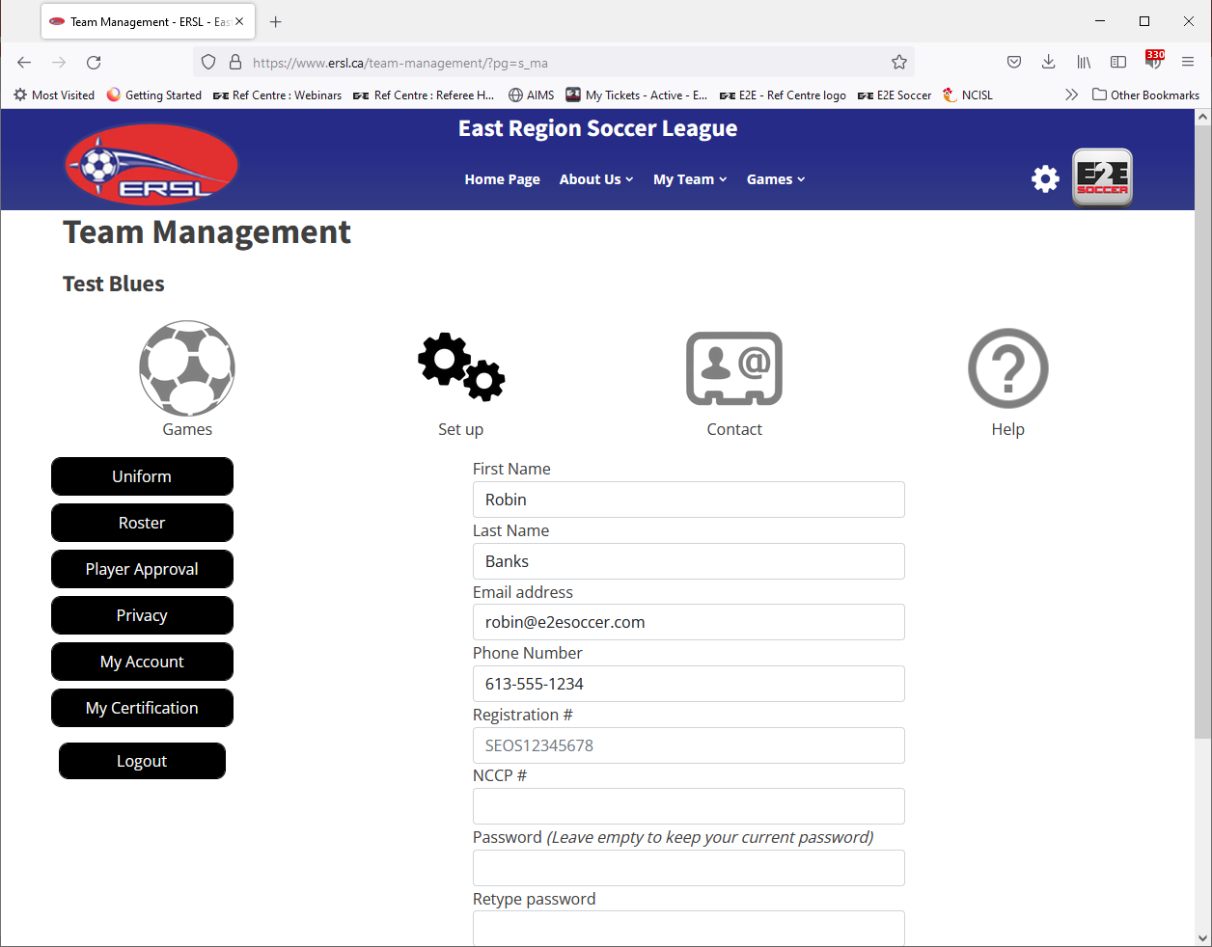
Use the My Account tool to update
your profile
Note that this coach has not
entered his NCCP #

Slide 27
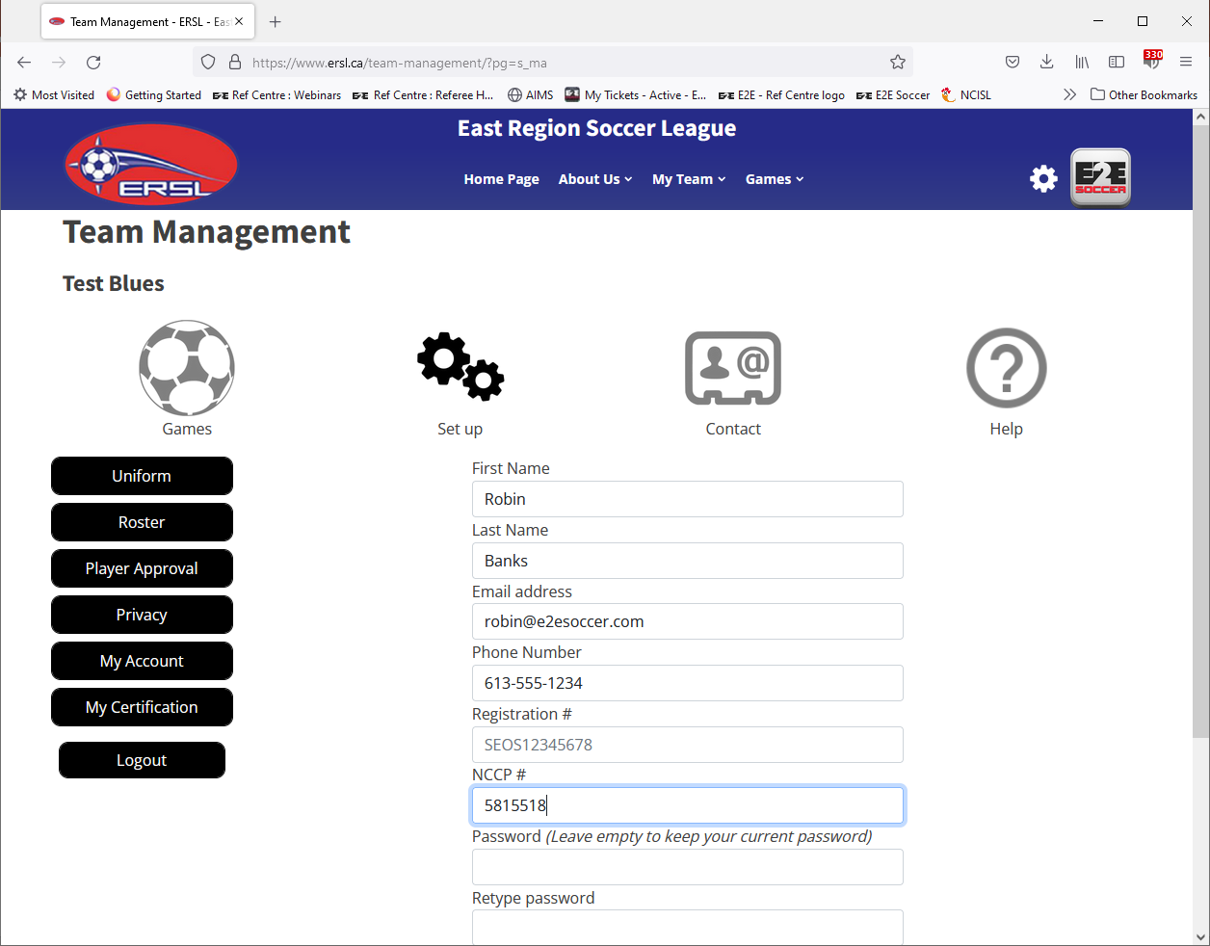

Slide 28
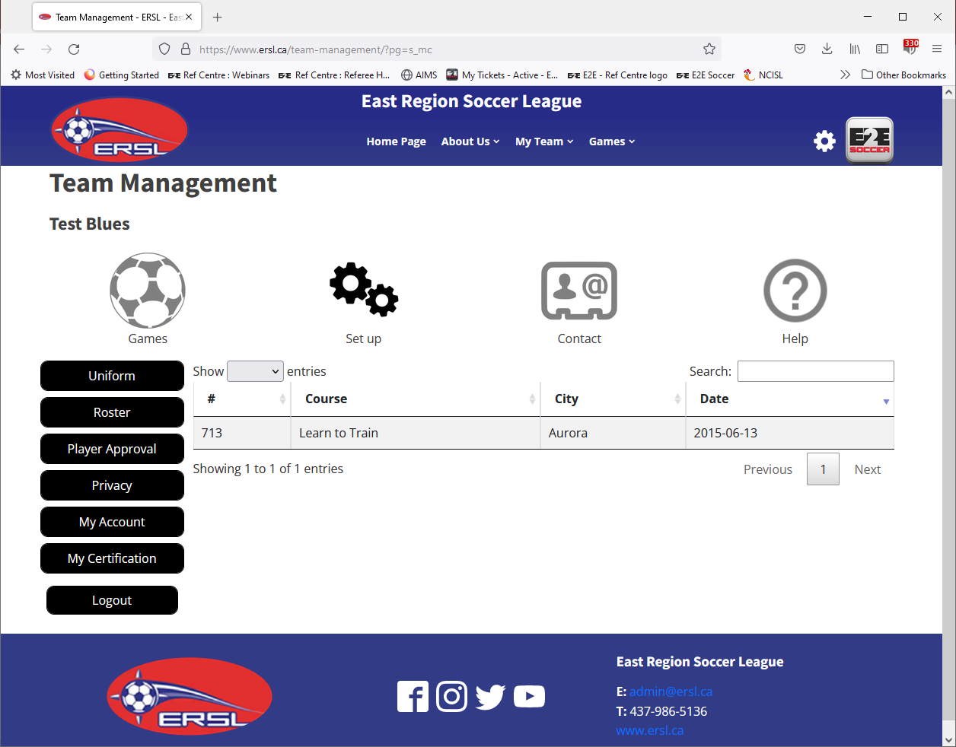
Now go to the My Certification tool
Now that the NCCP # has been
entered this account is linked to
Coach Centre and you can see
your certification
This information is also now available
to the league administrator

Slide 29
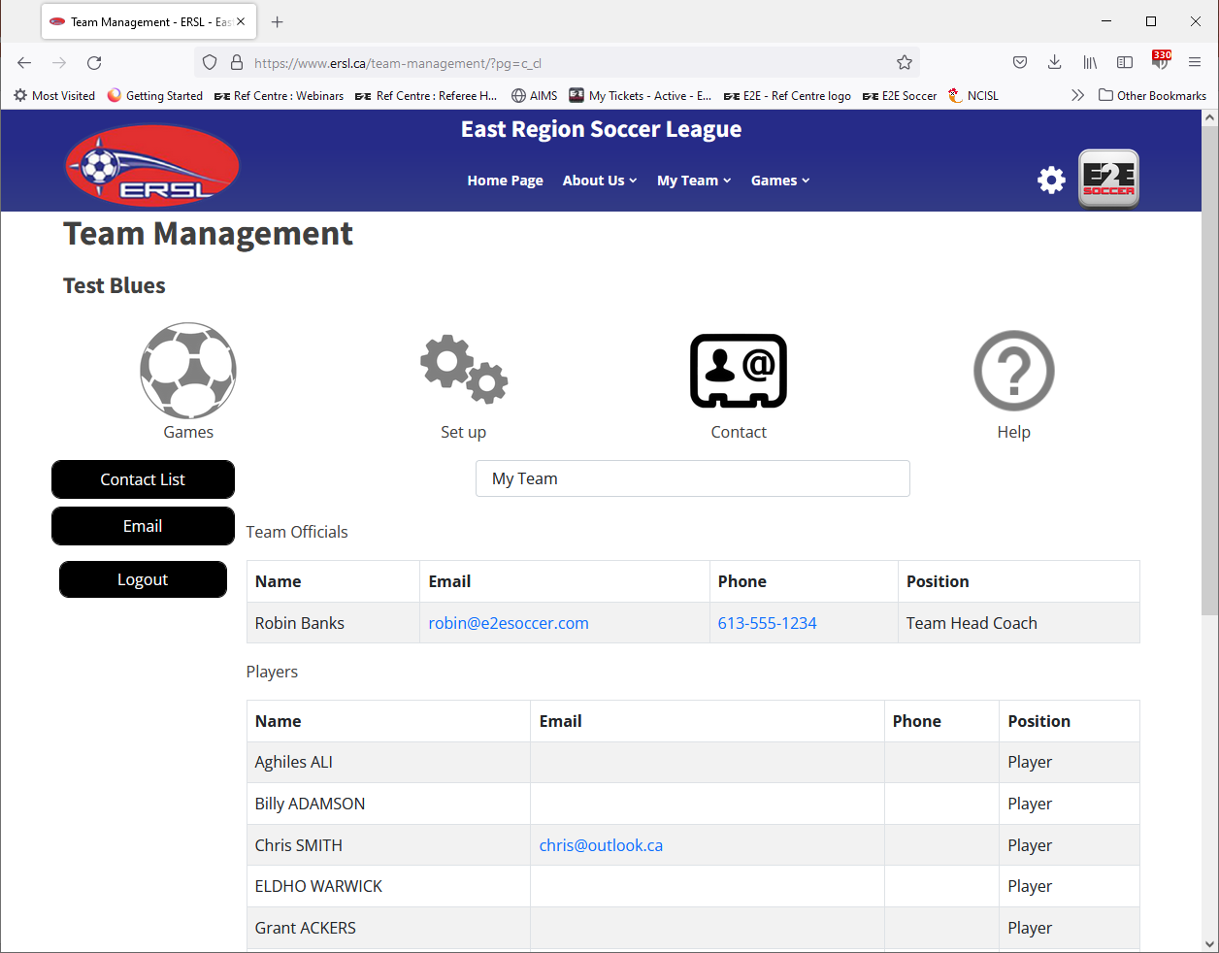
If you switch to the Contact section
you will be able to see the contact
information for your team
Use the drop down box here to see
the contact information of your
opponents (Team managers and
Coaches only)

Slide 30
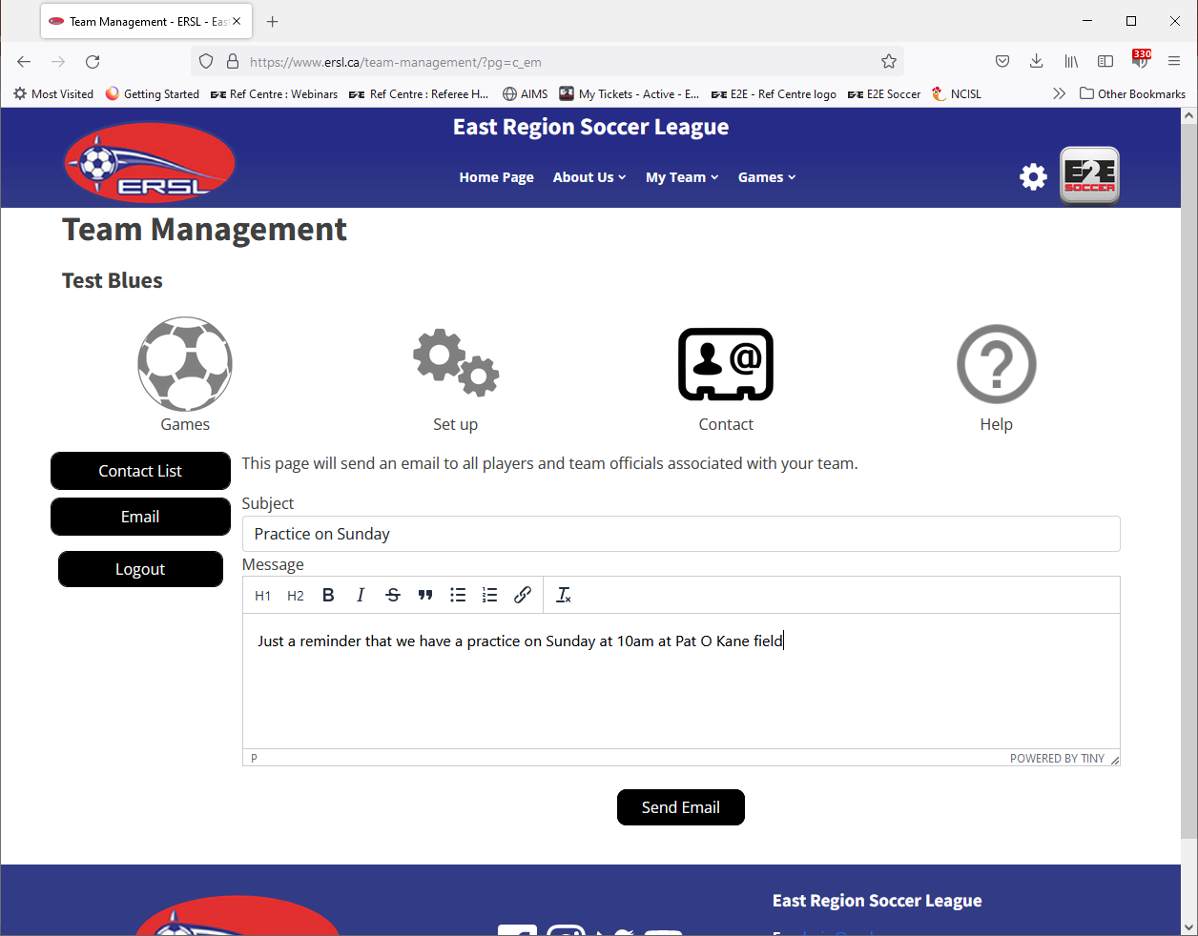
The Email tool allows you to
send group emails to your team

Slide 31
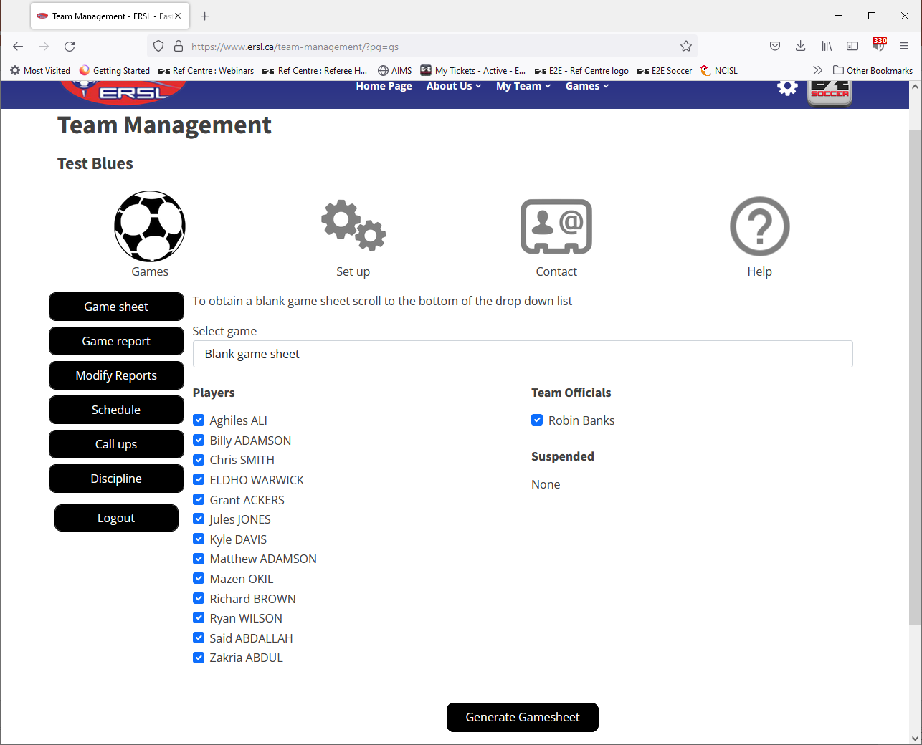
Game day duties
All your tools for games are in the Games section
On game day you will need to generate a
Game sheet
Check off your players and then click
‘Generate Game sheet’

Slide 32
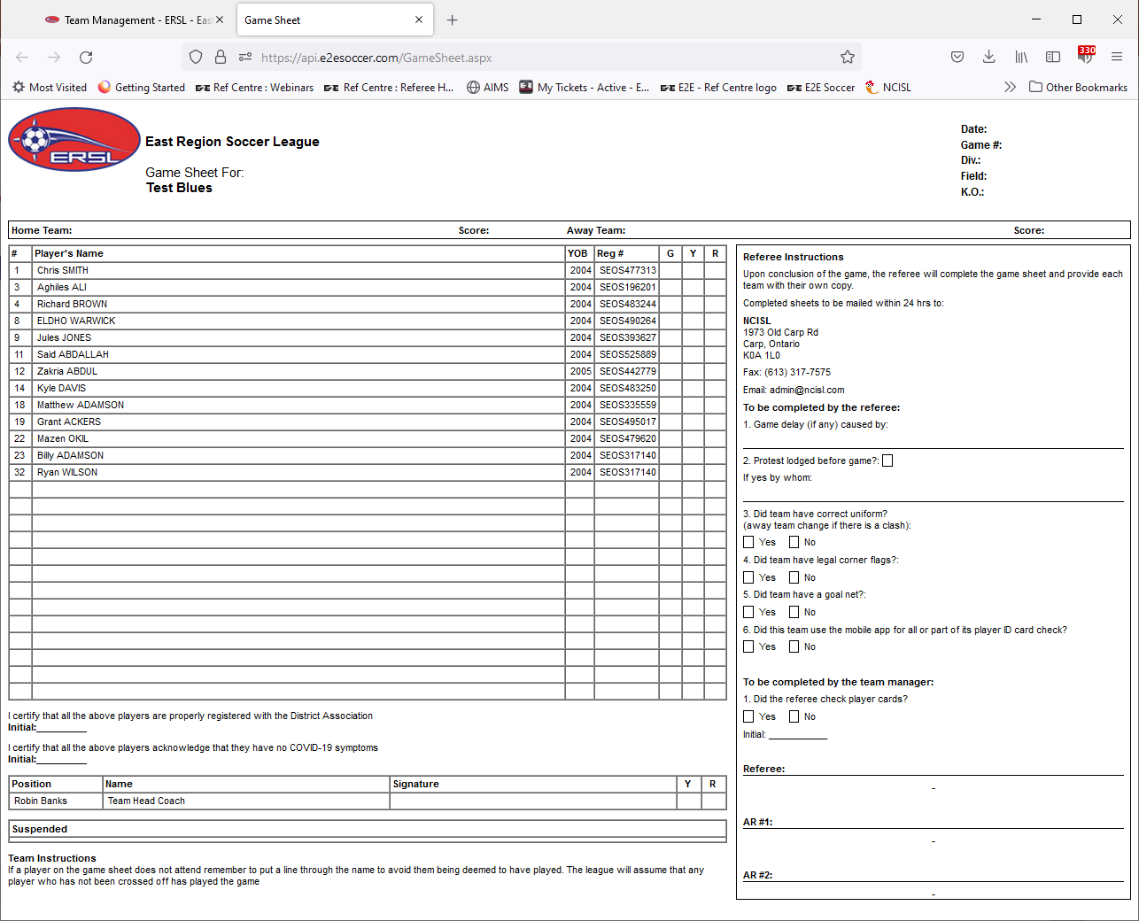
Print out 3 copies of the game sheets
Sign them and hand them to the
Referee prior to kick off

Slide 33
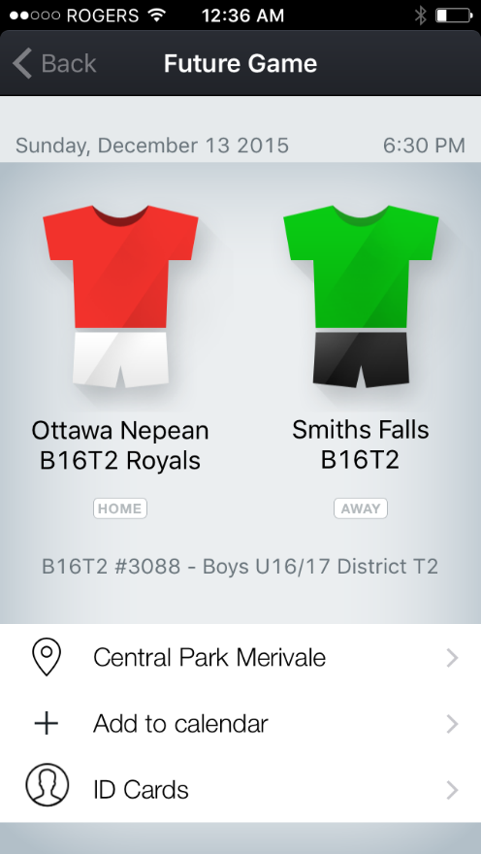
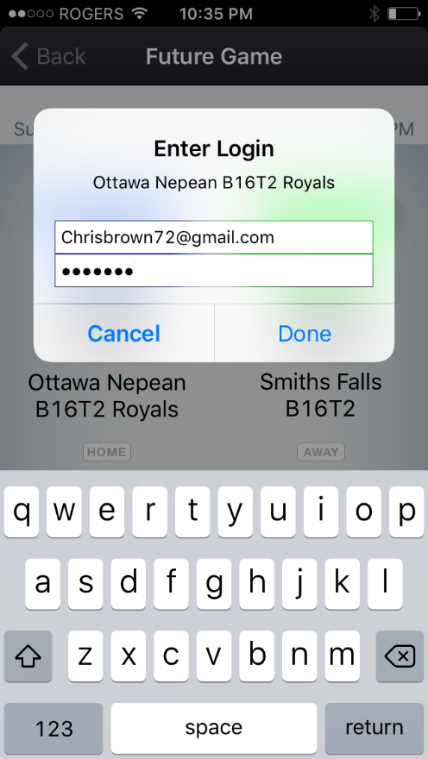
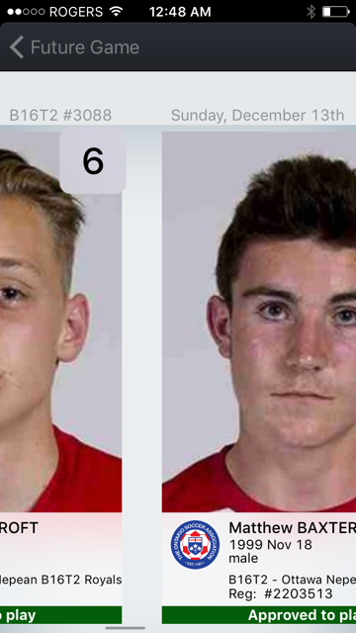

Digital ID Cards
Use the E2E League Centre
Mobile app to display your
digital cards
There are 3 steps to obtaining
Your ID cards. See below
Note that digital cards appear
only on the day of the game and
only after a game sheet has been
Printed
You will need to show player ID
before each game
1. Click here 2. Log in 3. ID will appear

Slide 34
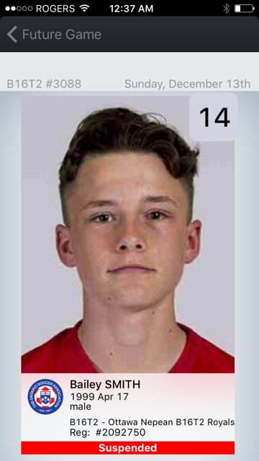
Each player ID show you
The division and game #
The date of the game
The players uniform number
The players name
The players date of birth
The players gender
The players regular division and team
The players Registration #
The players game status. In this example he is suspended for this game
1
2
3
1
2
3
4
4

Slide 35
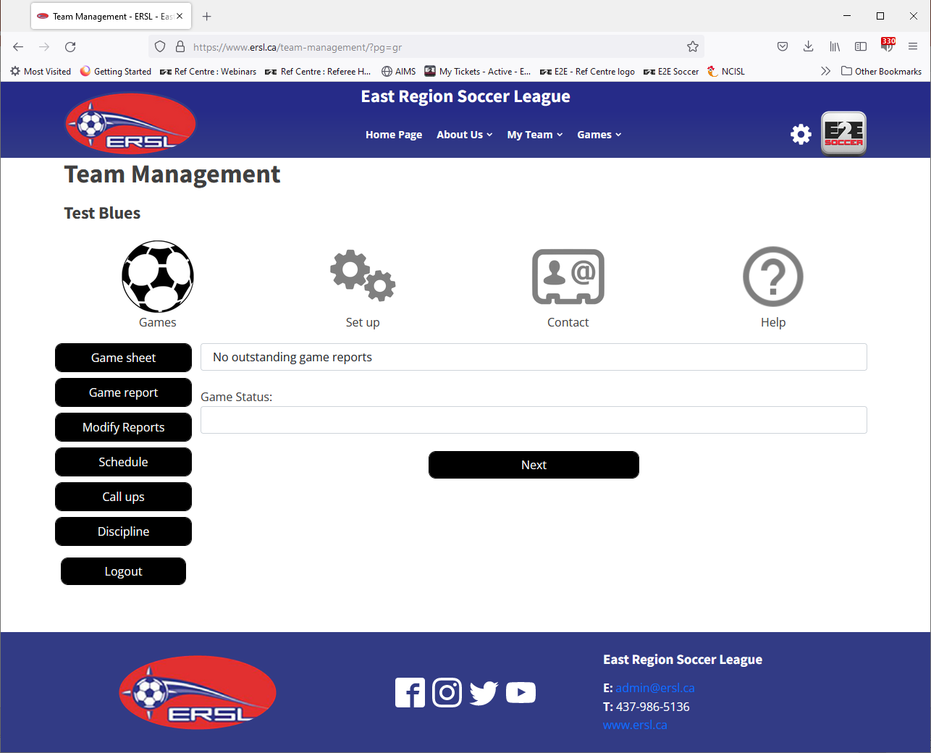
After the game collect your game
sheet from the referee
Then log in and submit a game report
The new web site should allow you to
submit a game report from the field
on your phone

Slide 36
Future software release training
We will let you know when the new software is available.
We will also publish some training slides for the new features.

Slide 37
Question Time
We will now take some questions on the new season.

